Slide 1
Final Project
2014 MSDA Programming Bridge
08/05/2014

Slide 2
Overview
Project Introduction
Data
Analysis Methods
Exploration
Comments on Applications of R vs. Python
Overall Conclusions

Slide 3
Introduction
Joint project of MSDA Programming Bridge students
Analysis utilized variety of functions and libraries
R
Python
Plotting
Matplotlib
Ggplot2
Key lesson – look at the data from a variety of perspectives, including scatter plot, before drawing final conclusions

Slide 4
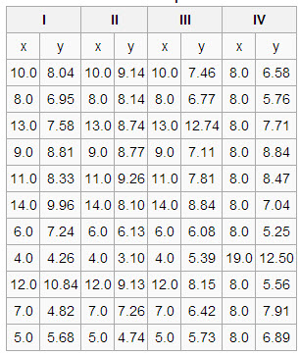
Data
Identified as “Anscombe’s Quartet”

Slide 5
Analysis Methods
Graphing Tools
Ggplot2
Matplotlib
Descriptive Statistics
Scatter Plots
Regression
Influence Measures: outlier impact
Durbin-Watson test: measure of correlation of residuals
Alternate Model

Slide 6
Descriptive Statistics
All four data sets “look” very similar
Mean
Variance
Skewness
Kurtosis

Slide 7
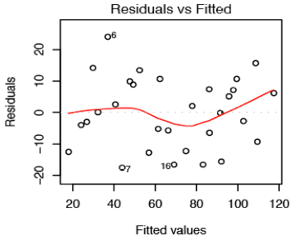
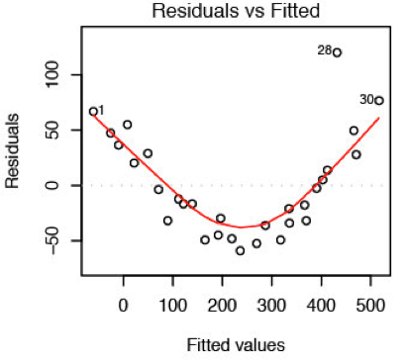
Regression - Linear
All four data sets produce the same best-fit line
Same Std. Error
Same p value
First discrepancies - residuals
Data Set I
Data Set II

Slide 8
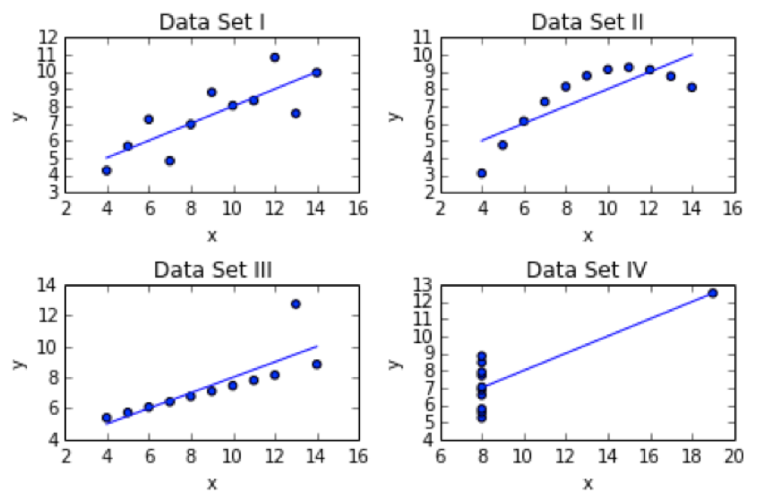
Scatter Plots

Slide 9
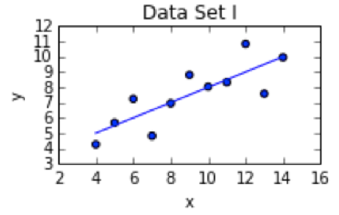
Regression – Data Set I, Linear
y= 0.5x + 3 R² = 0.67

Slide 10
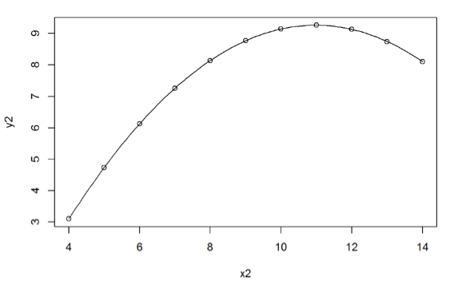
Regression – Data Set II, Polynomial
y = -0.127x² + 2.78x – 6.0 R² = 0.999

Slide 11
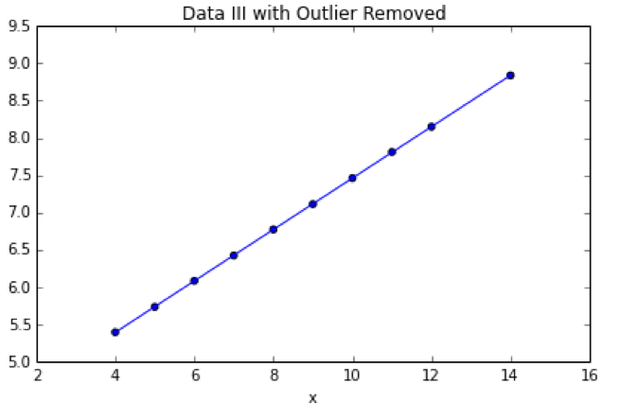
Regression – Data Set III, Linear
Excluding point (13, 12.74 )
y = 0.345x + 4.01 R² = 0.999

Slide 12
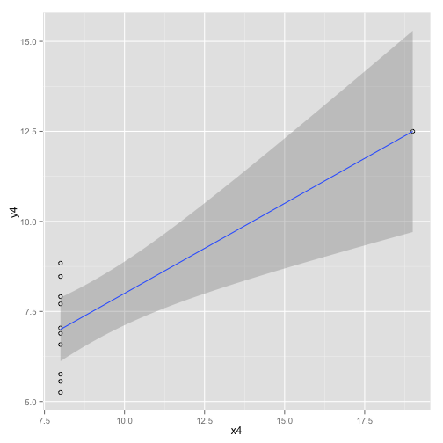
Regression – Data Set III, Linear
No further model improvement

Slide 13
Alternate Theory
x is the dependent variable, y’s are predictors
x = 0.71y₁ = 0.32y₂ + 0.81y₃ – 4.83 R² = 0.92

Slide 14
R vs. Python
Data Load
R – native solutions from .csv
Python
Pandas
Numpy
Statistical Analysis
R – native capabilities
Python – use scipy package
Basic Plots
R – native
Python - none

Slide 15
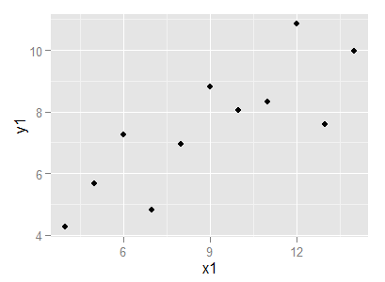
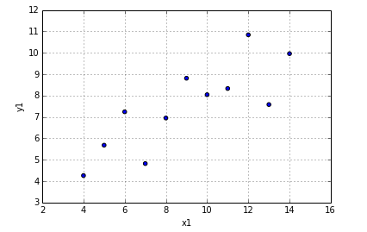
R vs. Python
Advanced Plots
R – ggplot2
Python – matplotlib
Graphs
ggplot2
matplotlib

Slide 16
Open Discussion

